Slide 1

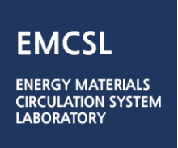
PAPER PRESENTATION
Student: NGUYEN THANH PHUONG
ID: 202355342
Class: Computational Thermal Engineering

Slide 2
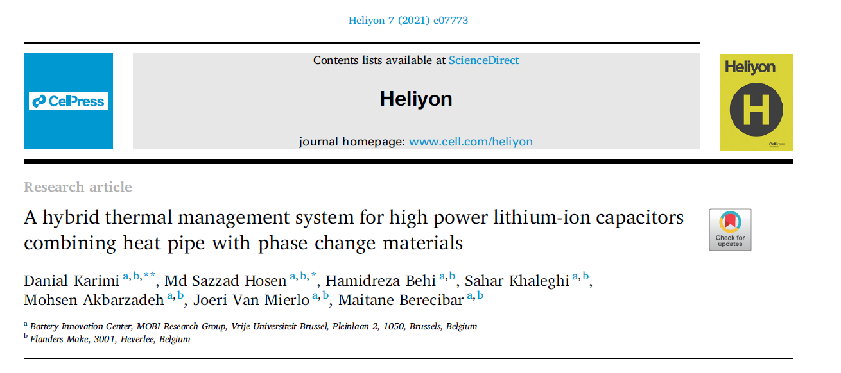

Slide 3
1. Introduction
2. Experimental methodology
5. Validation results and discussion
3. Experimental results and discussion
4. Numerical analysis
6. Conclusion

Slide 4
1. Introduction
Fossil fuels are the major global warming so moving to renewable energies as an infinite power supply to protect the environment and for long-term sustainability
Energy storage systems include Lithium-ion batteries (LiB) and electric double-layer capacitors (EDLC)
LiB
EDLC
Low power density
Short lifetime
+
Low energy density
Low voltage
Li-ion Capacitor
(LiC)
Excessive heat
Higher energy density and higher voltage
Higher power density and longer lifetime

Slide 5
1. Introduction
Thermal management system (TMS) for LiC
Active cooling
Hybrid cooling
Passive cooling
Air-cooling
Liquid-cooling
Refrigerant- cooling
Phase change material
Heat pipe

Slide 6

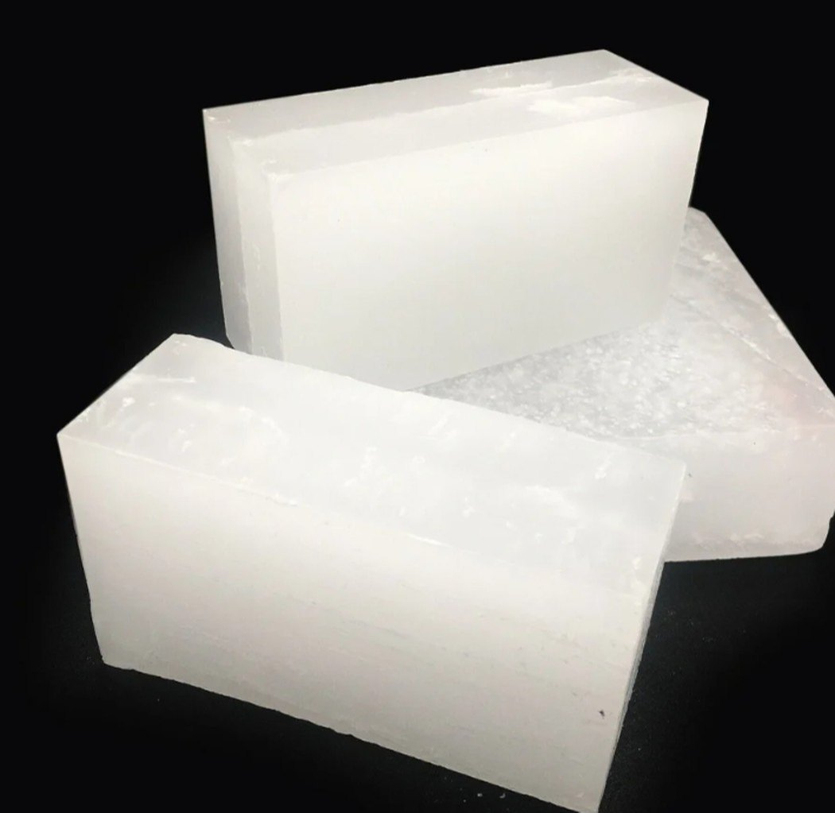
1. Introduction
Phase change materials (PCM) can absorbs and release high large heat by phase change process but very low thermal conductivity
Heat pipes TMS can benefit from high thermal conductivity but small thermal contact area
From the authors' best knowledge, no work used TMS heat pipe or PCM, especially hybrid TMS for the LiC technology with a fast 150 A charge/discharge current rate
This work investigated the HTMS using flat heat pipe and PCM to control the maximum temperature and the temperature uniformity for high power applications of LiC.
Fig. Flat HP
Fig. Paraffin wax (PCM)

Slide 7
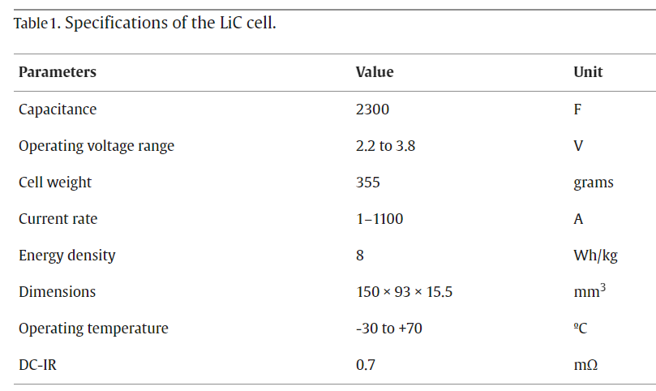
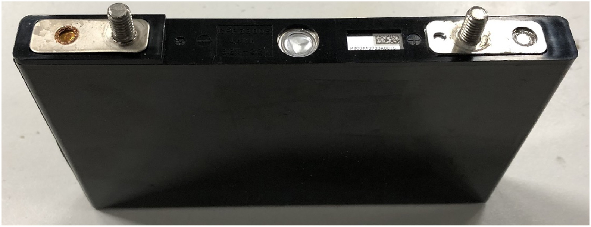
2. Experimental methodology
2.1. LiC cell description
Fig. The commercial prismatic 2300 F LiC cell.

Slide 8
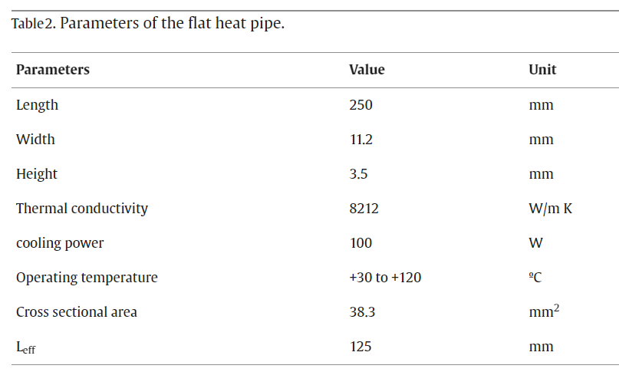
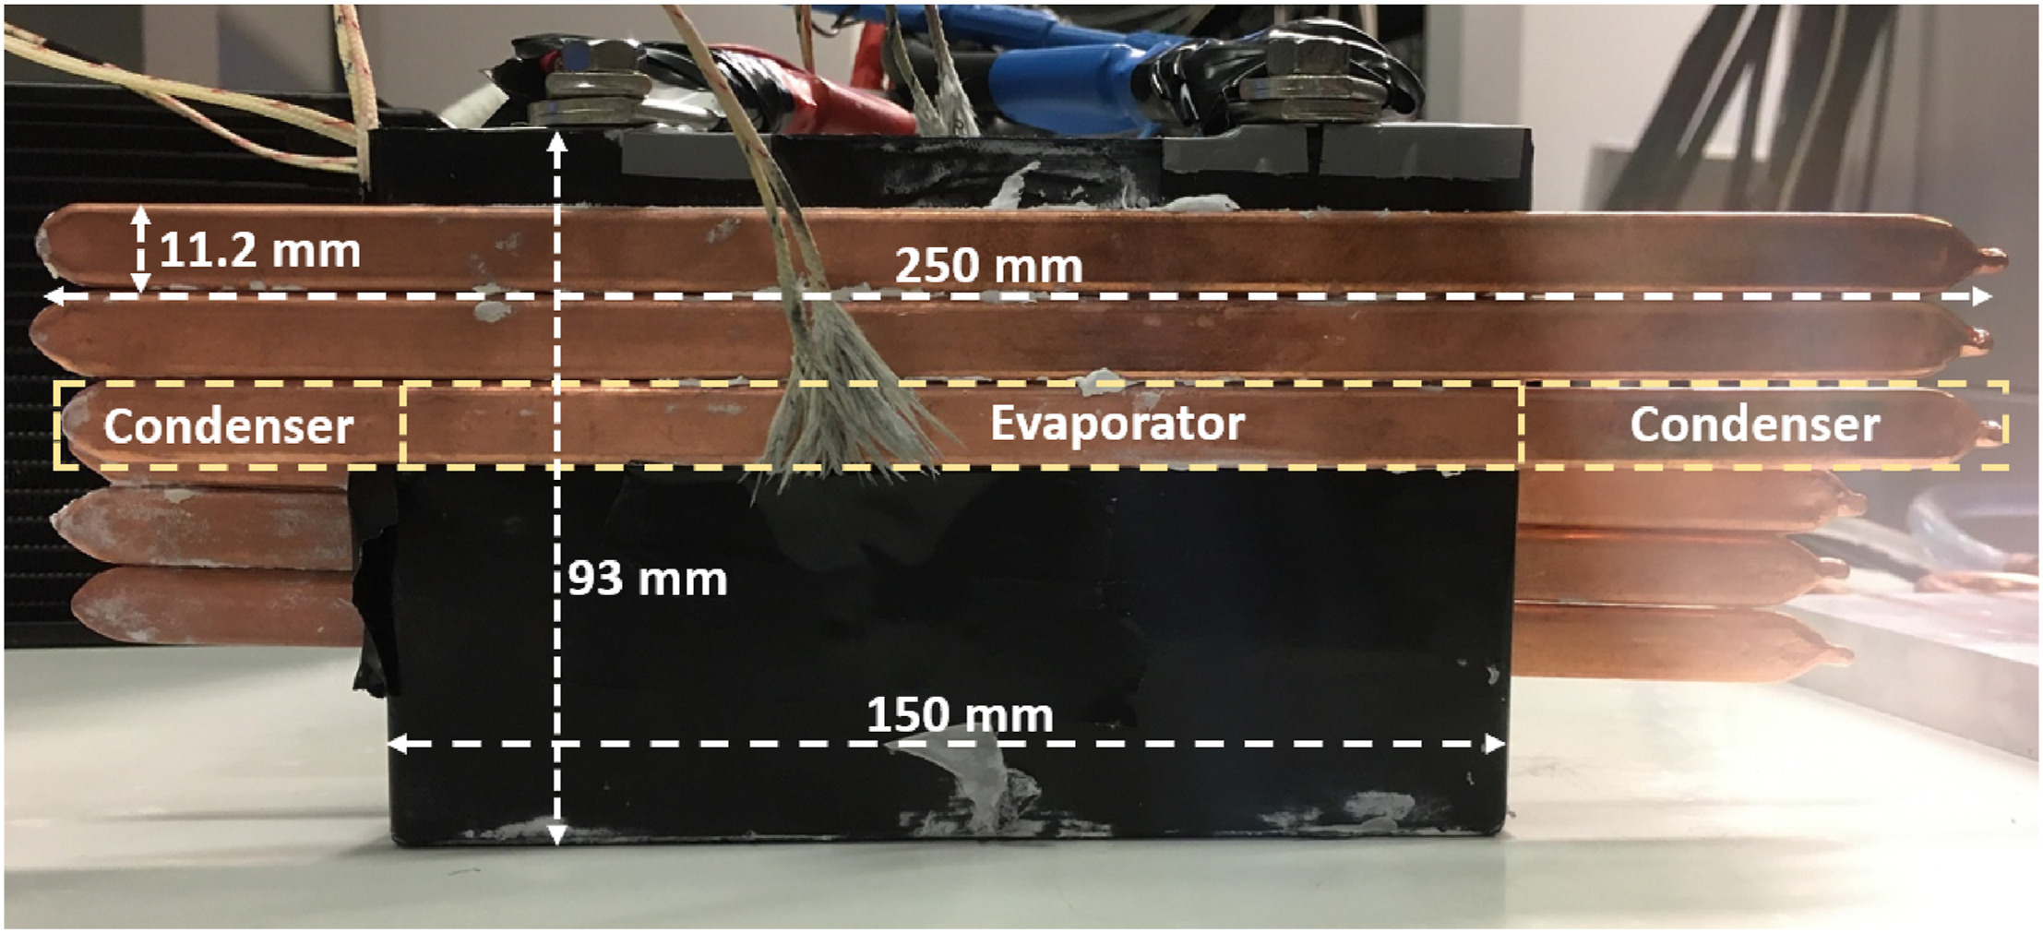
2. Experimental methodology
2.2. HP description
Fig. Flat HP dimension and position

Slide 9
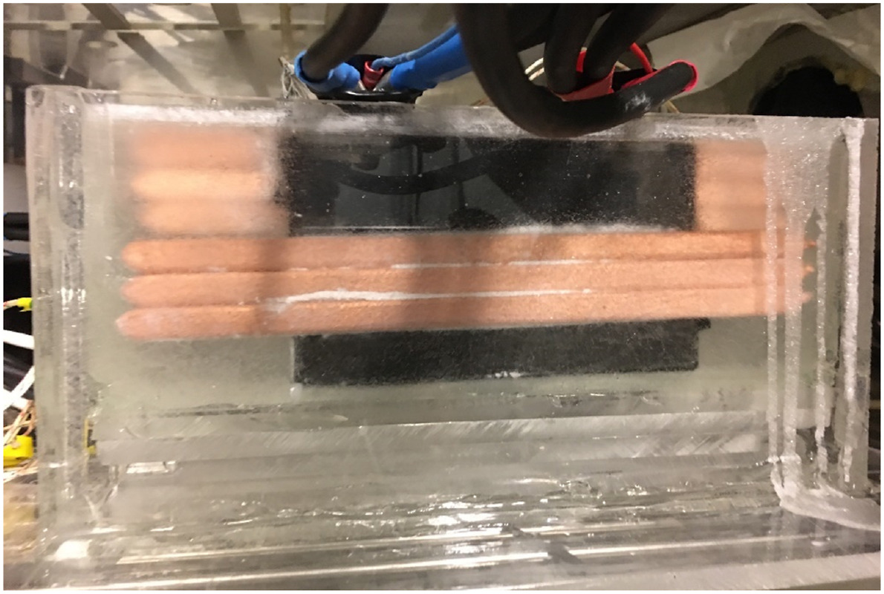
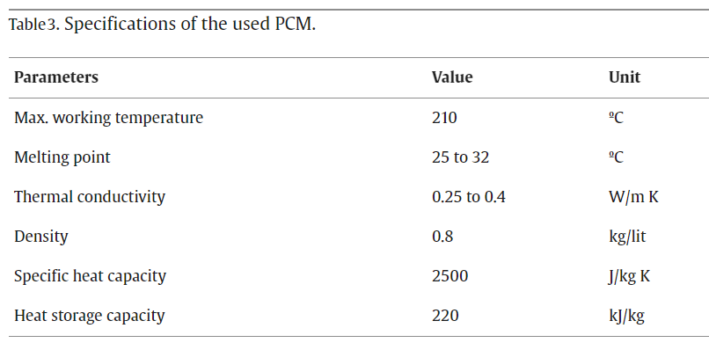
2. Experimental methodology
2.3. PCM description
Fig. LiC and the heat pipes that are immersed in the PCM container

Slide 10
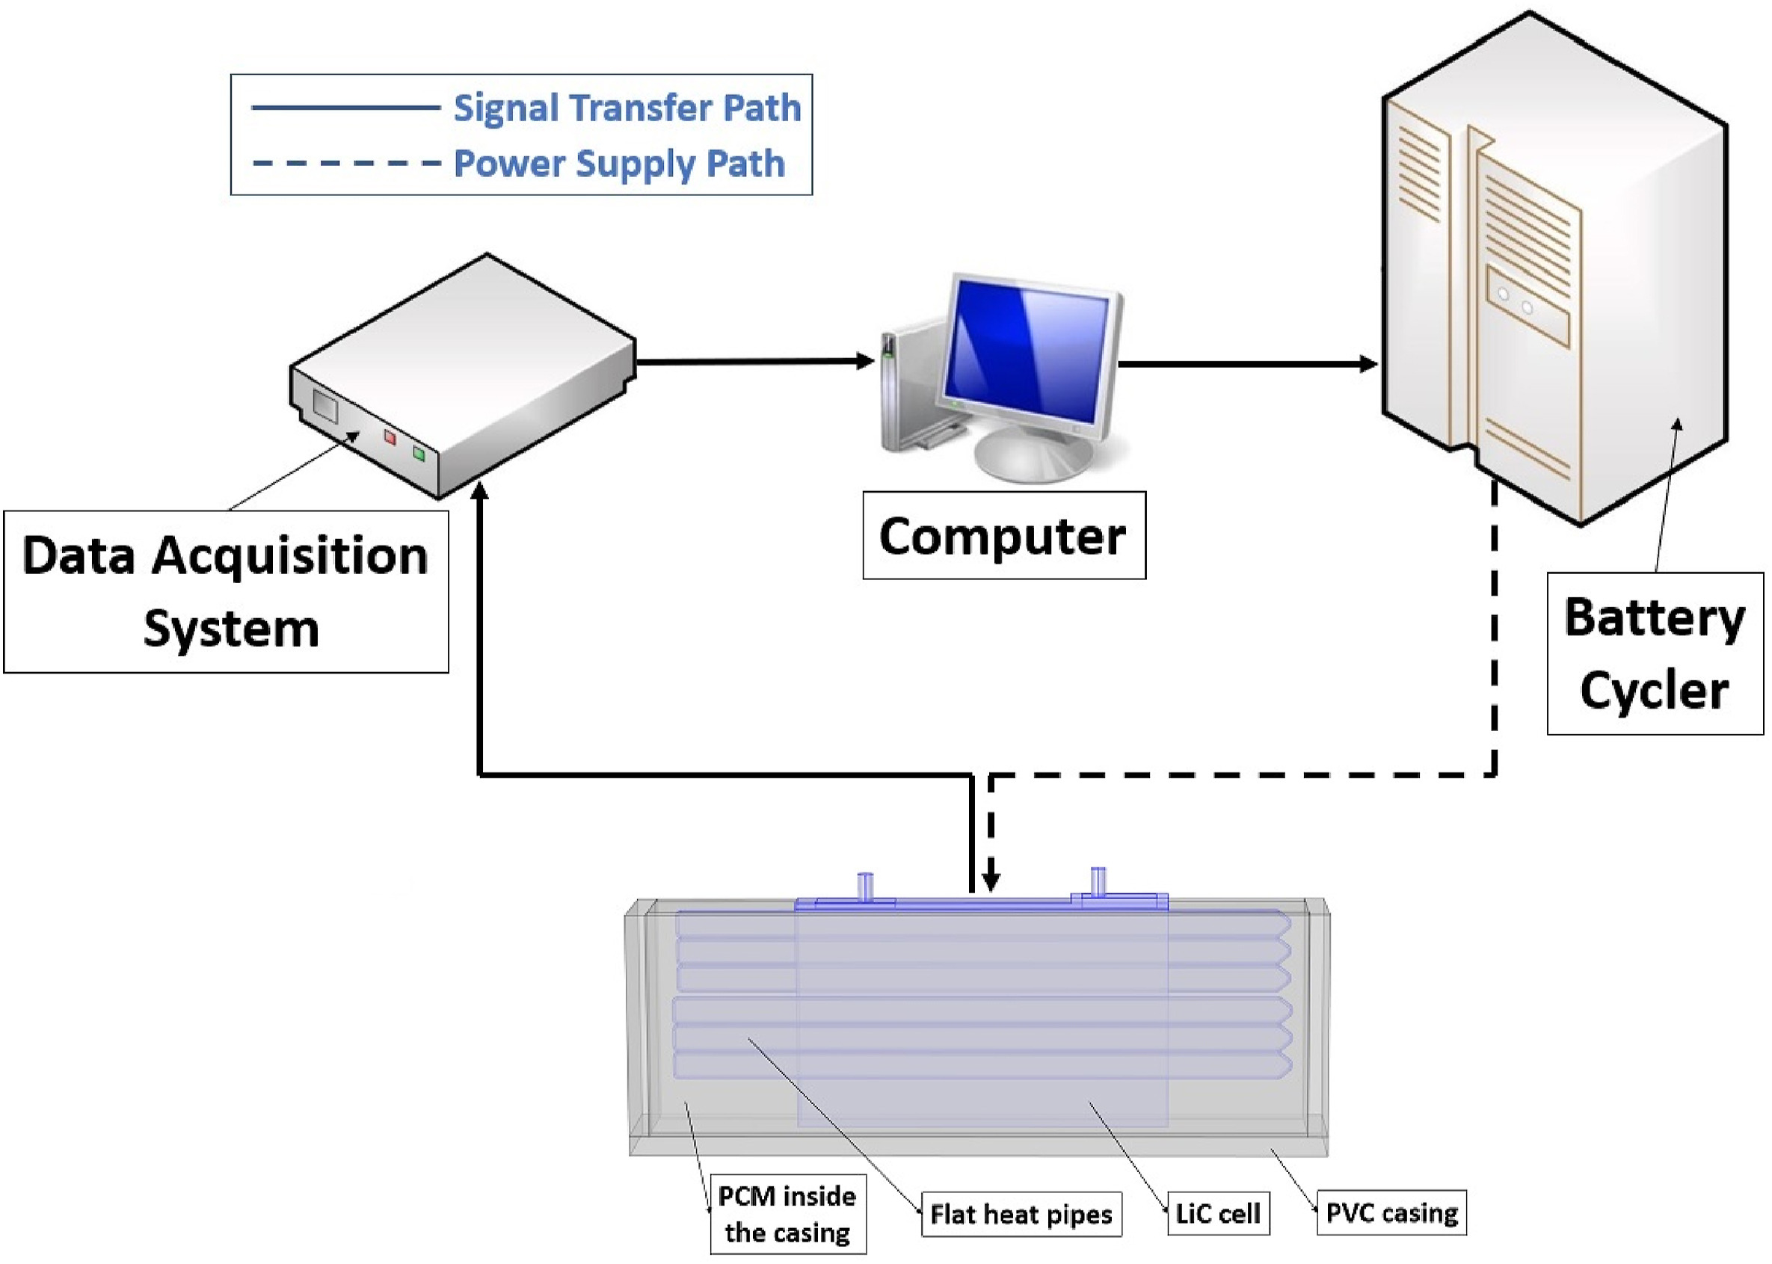
2. Experimental methodology
2.4. Experimental test bench
From the current, voltage and resistance of the cell, the generated heat can be calculated and fed in to numerical model

Slide 11
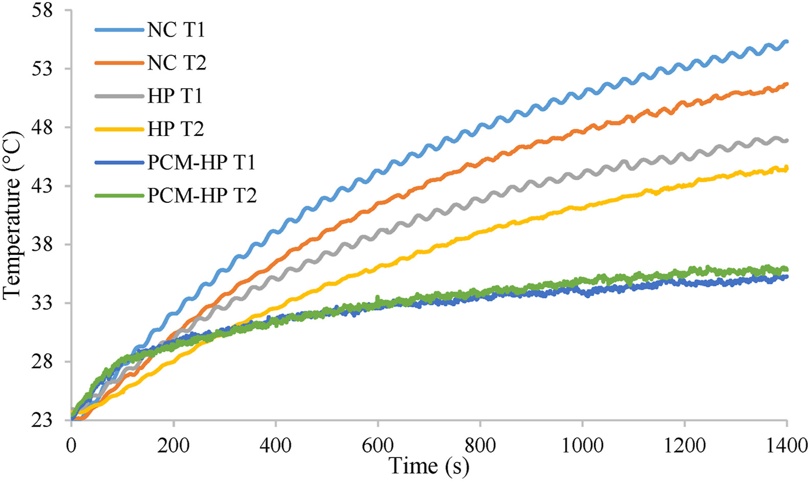
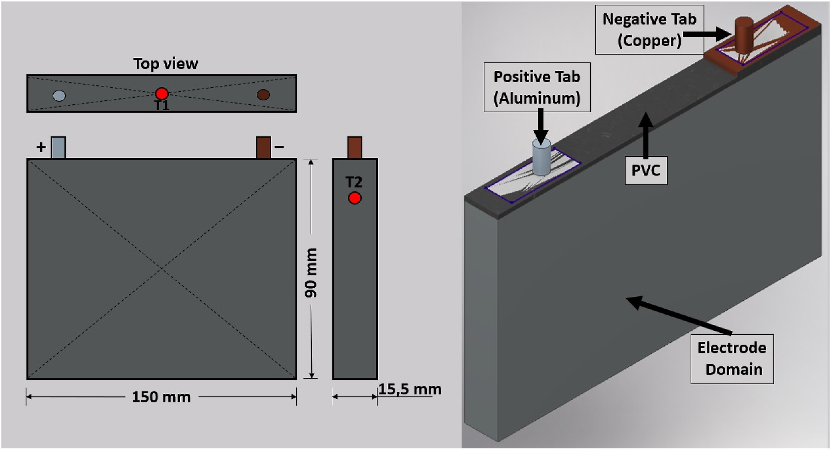
3. Experimental results and discussion
1st case study (CS): Natural convection - heat transfer coefficient between the cell surface and the environment is low
2nd CS: Only HP - high thermal conductivity → max temperature (temp) and temp difference decrease
3rd CS: hybrid TMS HP + PCM – max temp only 35.8 °C and 35.2 °C, temp difference 0.5 °C (optimal operating condition LiC)
Fig. Cell domain and thermocouple positions
Fig. Temperature evolution of the LiC cell for the three use cases

Slide 12
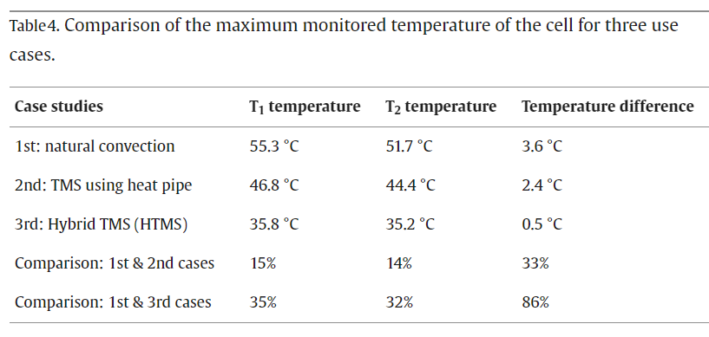
3. Experimental results and discussion

Slide 13
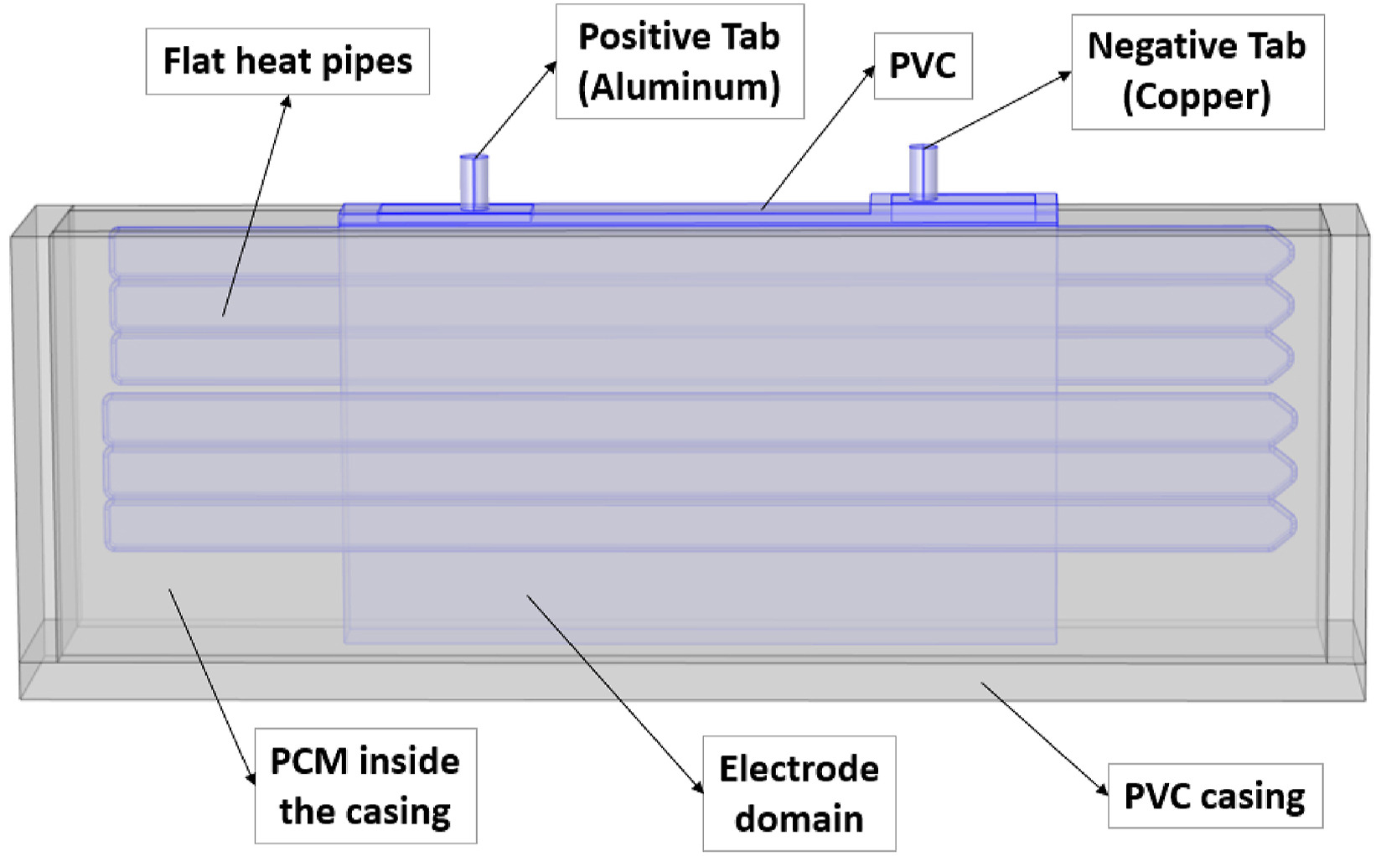
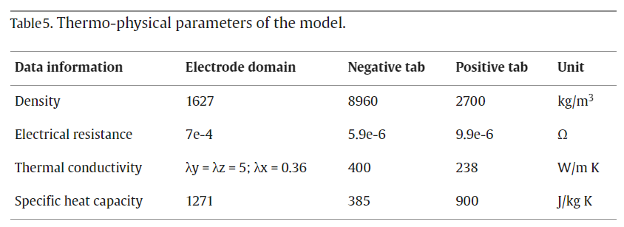
4. Numerical analysis
4.1. Geometric construction
Using 1D MATLAB SIMULINK® software for the electro-thermal modeling, 3D Autodesk Inventor software for the CAD design, and 3D COMSOL Multiphysics software using FEM for the computational fluid dynamics (CFD) analysis
Fig.Geometry of the HTMS

Slide 14
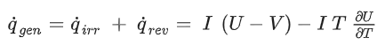
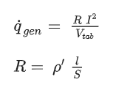
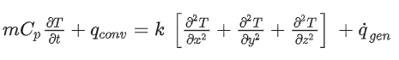
4. Numerical analysis
4.2. Governing equations
The heat generation of the LiC cell
The heat equation for the tab domain
The energy balance equation

Slide 15
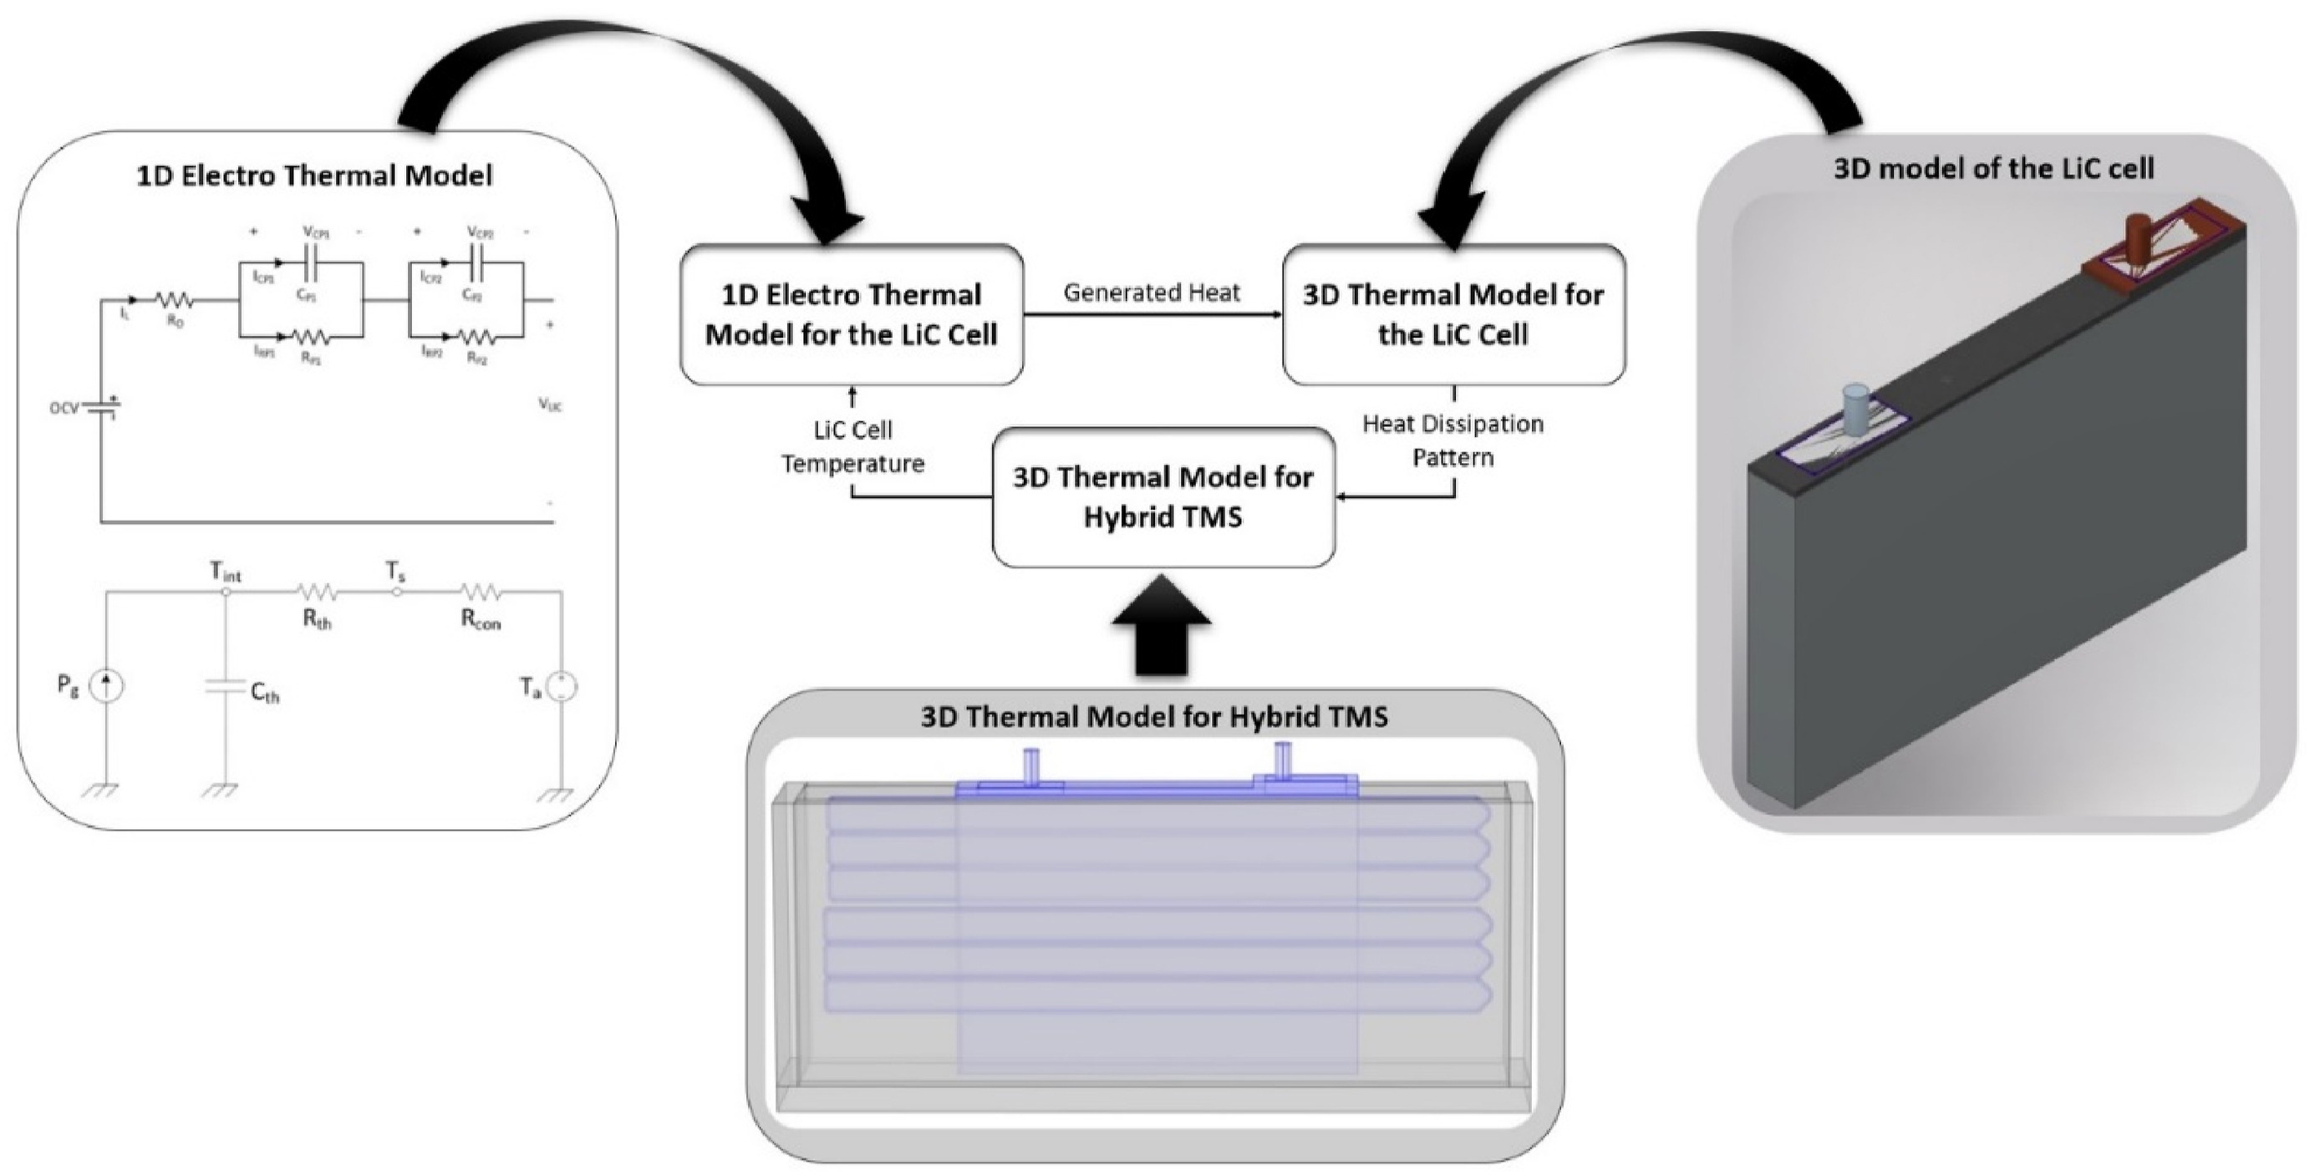
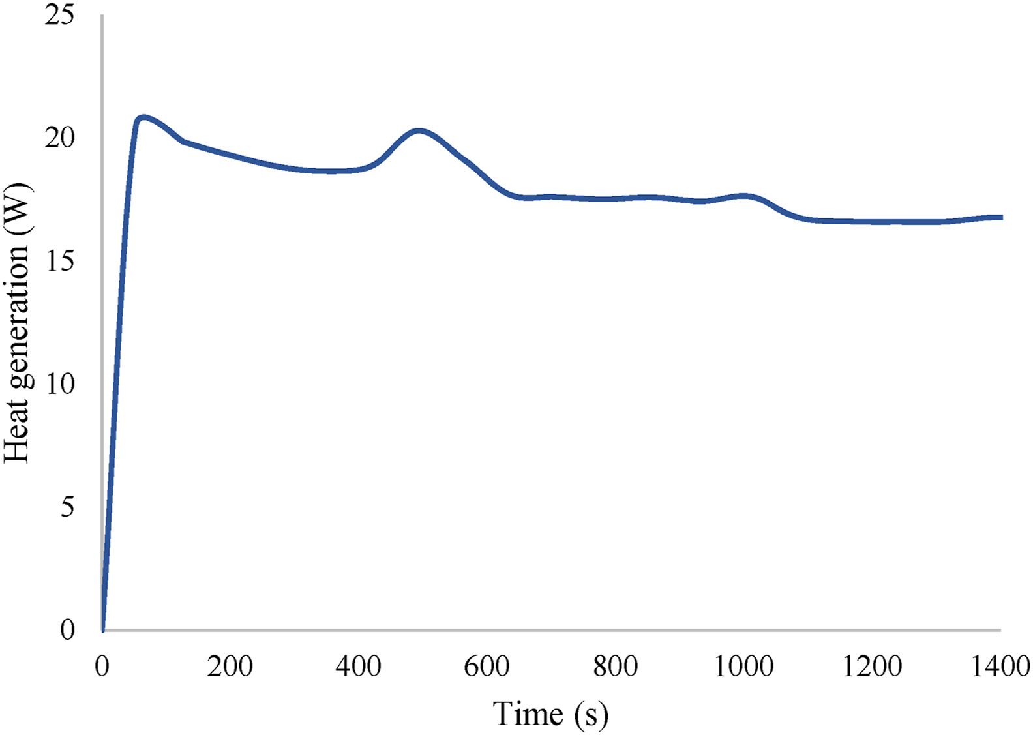
4. Numerical analysis
4.2. Governing equations
Fig. The heat generation of the LiC cell
Fig. The modeling methodology to show the relation between 1D and 3D models

Slide 16
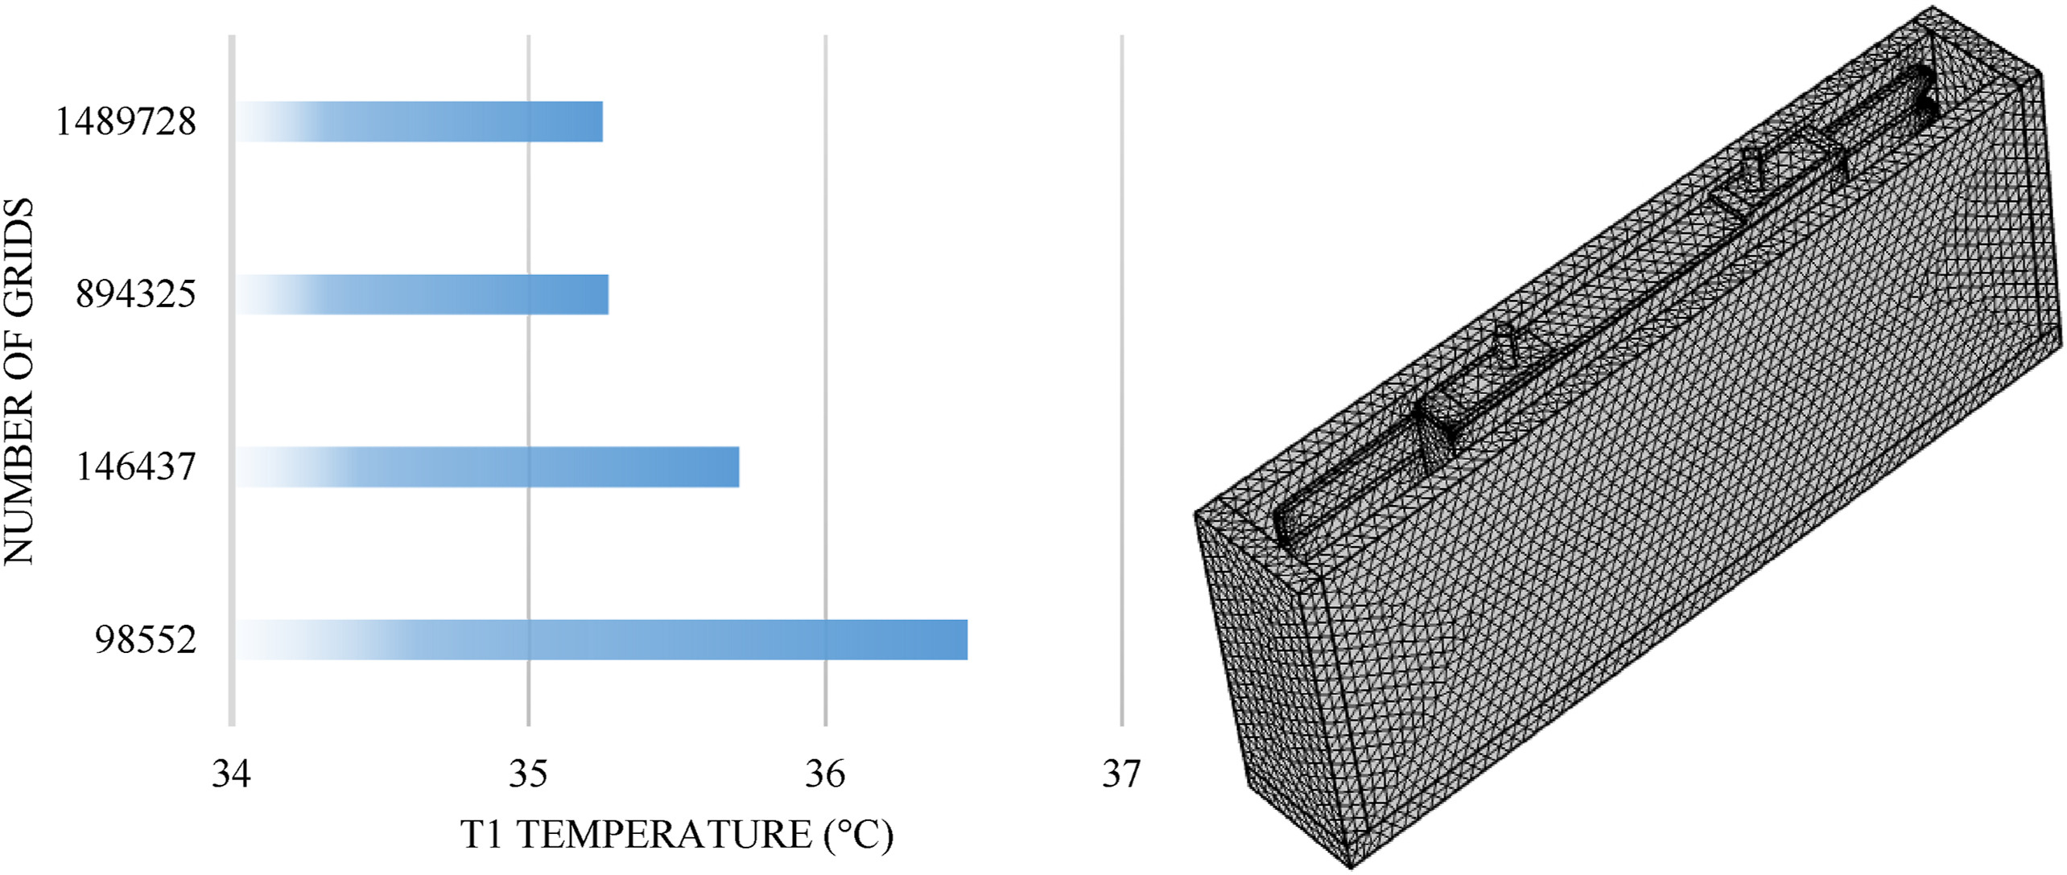
4. Numerical analysis
4.3. Generation of the mesh and grid independence of the thermal model
ΔT 0.2 °C
Fig. Grid independency analysis
Fig. The generated tetrahedral mesh of the HTMS
Selection of time step is 1 s, heat transfer coefficient is 13 W m⁻². K⁻¹

Slide 17
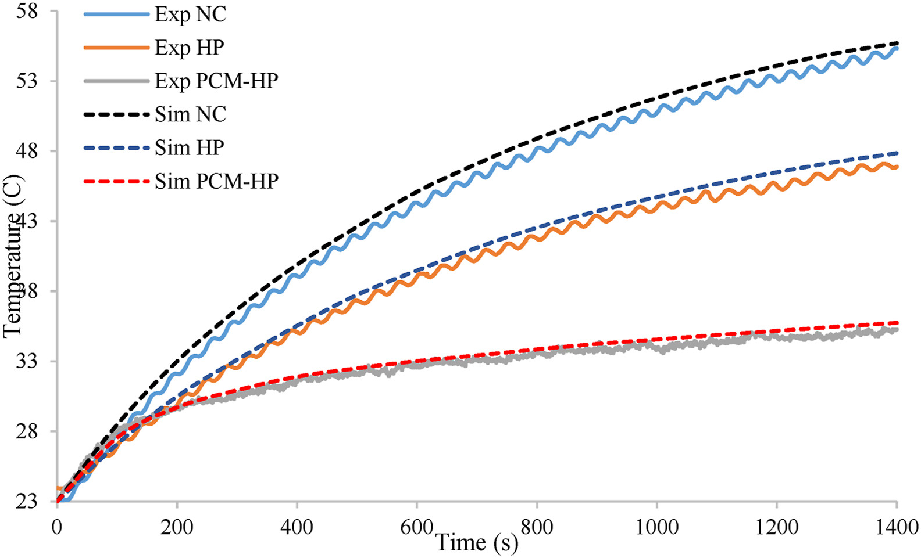
5. Validation results and discussion
Fig. Verification of the numerical and experimental results

Slide 18
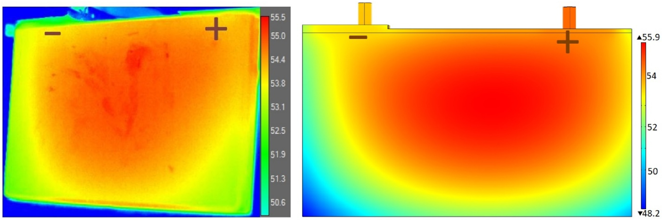
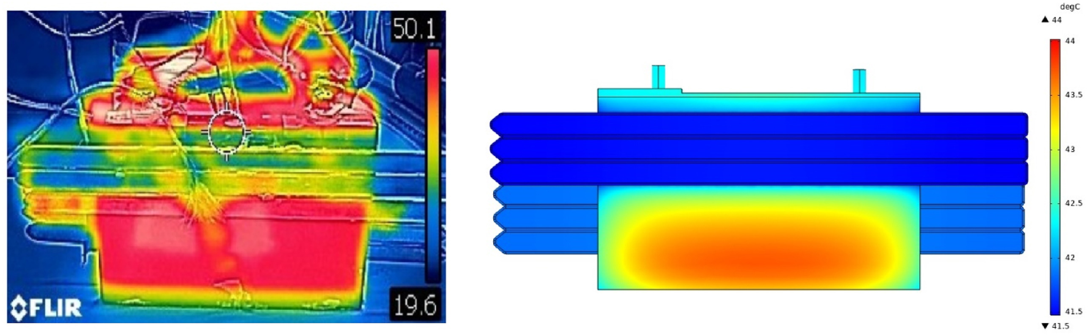
5. Validation results and discussion
5.1. 1st CS: Natural convection
Fig. The temperature profile of the LiC cell under natural convection at 1400 s
5.2. 2nd CS: HP TMS
The temperature profile of the LiC cell using six flat heat pipes

Slide 19
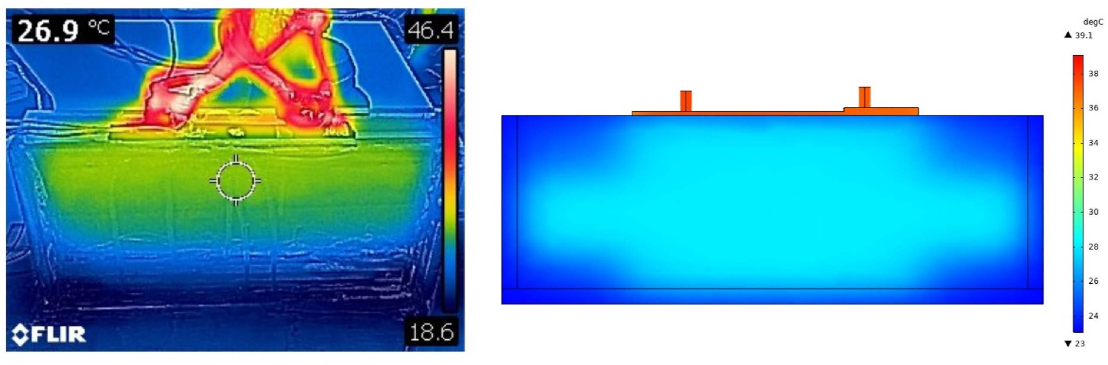
5. Validation results and discussion
5.3. 3rd CS: Hybrid TMS HP + PCM
Fig. The temperature profile of the LiC cell using PCM and six flat heat pipes

Slide 20
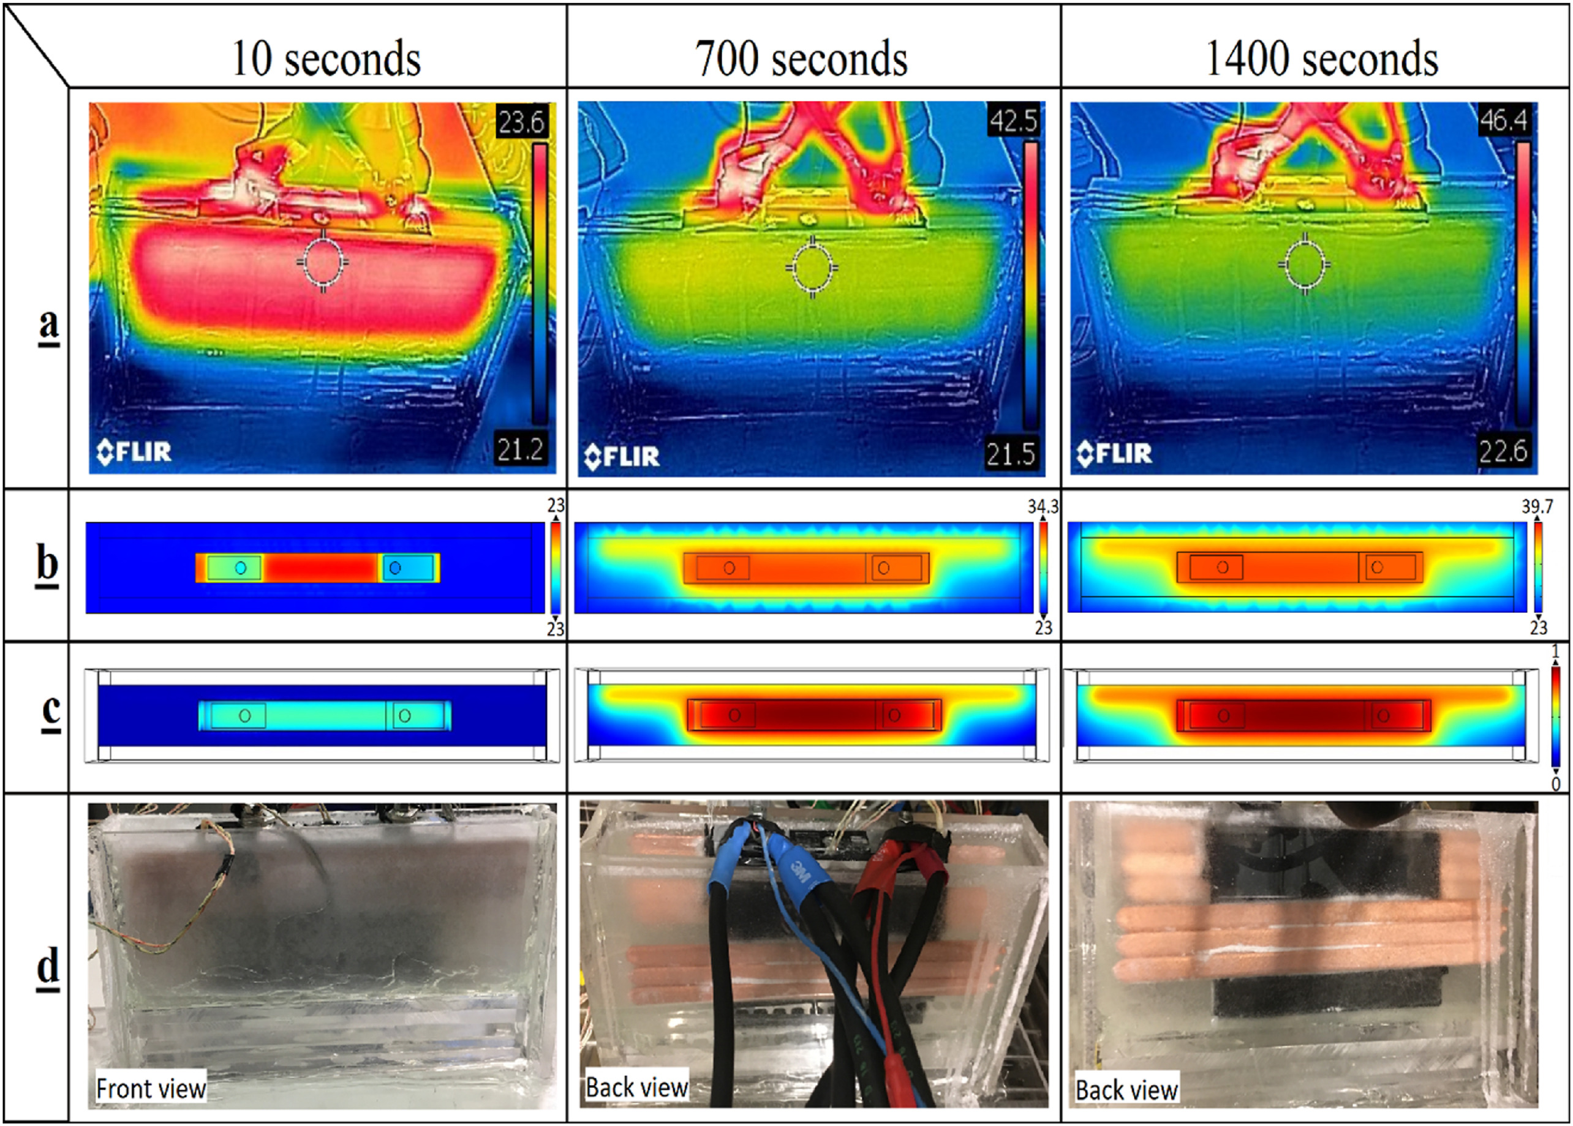
5. Validation results and discussion
5.3. 3rd CS: Hybrid TMS HP + PCM
Fig. (a) Thermal images, (b) maximum temperature of the LiC cell, (c) solid-liquid fraction PCM (d) real-time PCM state

Slide 21
6. Conclusion
HTMS for LiC technology during high charge/discharge applications is quite robust to maintain the maximum cell temperature and to enhance the temperature uniformity.
The developed method is verified for a single cell. Applying the same methodology and verification of the models for a module or a pack will be the next plan

Slide 22

THANK YOU

